Slide 1
UMBC COEIT Undergraduate Advising Project
By Jeremy Suon and Jeanice Hwang

Slide 2
Jeremy Suon
Sophomore
Computer Science Major
Relevant experiences:
QA Intern for Xerox – Germantown, MD June 2014 – August 2014
Created code which would collect and report data in Python leveraging an SQL database.

Slide 3
Jeanice Hwang
Senior
Biological Sciences, Bachelor of Science Major
Computer Science Minor

Slide 4
Project Demonstration

Slide 5
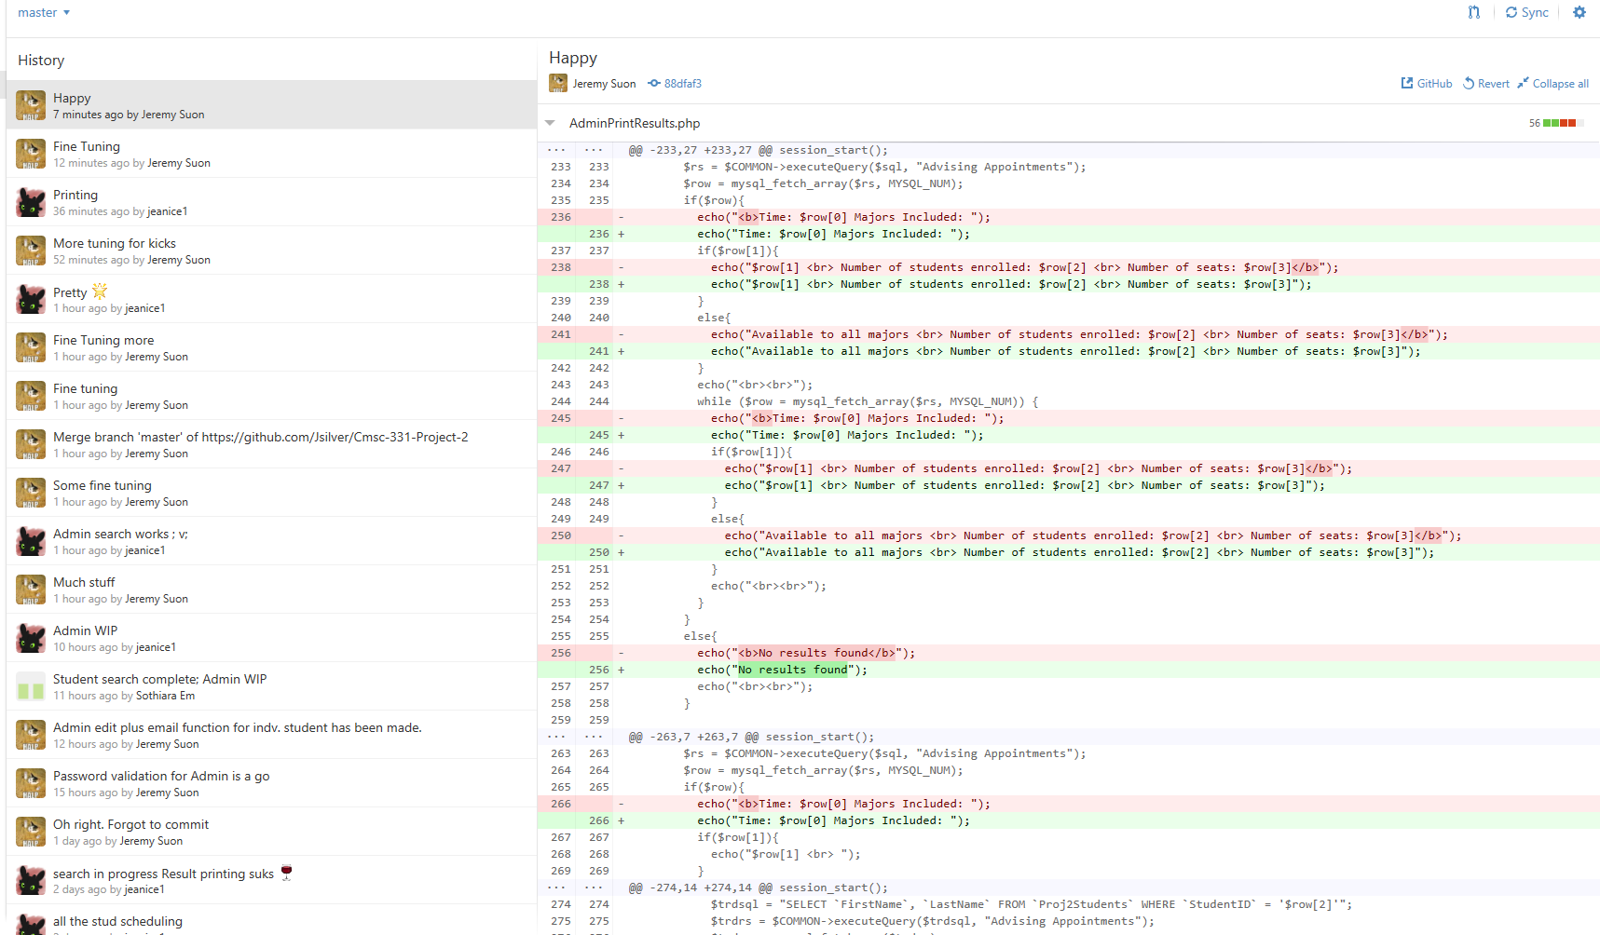
Repository
Github

Slide 6
Challenges
Understanding different coding styles
Working with PHP was a new experience to the both of us
One of our project members dropped the class
Both of us, the remaining project members worked on the same portion of the project during the first half of the semester

Slide 7
Next Release
One of the features included in our code was an email function that would email students about a cancellation of their appointment if the advisors would ever need to cancel it.
What we would change would be to include a link to the advising webpage within the email rather than simply informing the student about the cancellation.
Functions to move back and forth between pages more smoothly.
Lacking of back buttons
On the advisor side, the inclusion of an edit function where advisors would be able to edit their own information if they were to choose to do so.

